Slide 1
auth

Slide 2
First install stuff
npm install express-session
npm install @types/express-session
npm install passport passport-google-oauth20
npm install @types/passport @types/passport-google-oauth20
npm i @quixo3/prisma-session-store

Slide 3
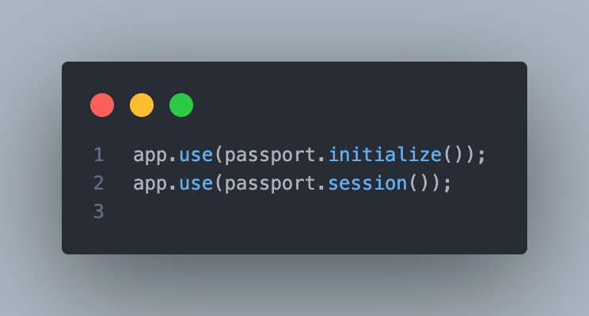
Add
passport.initialize() is a middleware that initializes Passport authentication. If you want to maintain persistent login sessions (which is typical in web applications), passport.session() middleware must be used. This ensures that, once the user logs in, every subsequent request will check and deserialize the user from the session to keep them logged in.

Slide 4
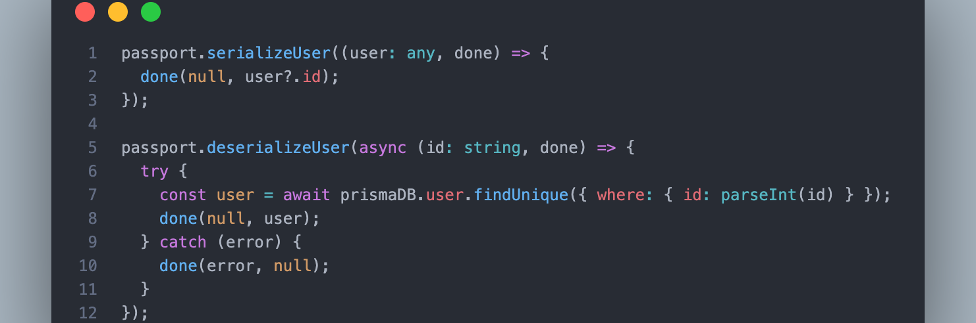
serializeUser and deserializeUser
serializeUser answers: "What data from the user object should I store in the session?"
deserializeUser answers: "Given this piece of data from the session, how do I retrieve the full user object?"

